Slide 1
Cluster Analysis

Slide 2
Today . . .
  Additional clustering methods
  Evaluating cluster quality
  Mixed measures

Slide 3
Additional clustering methods attempt to improve upon limitations in classical approaches:
Partitioning Around Medoids (PAM)
Minimax Clustering
Density-Based Clustering (DBSCAN)
Fuzzy Sets
Minimum Spanning Trees

Slide 4
The Partitioning Around Medoids (PAM, Kaufman & Rousseeuw (1990) attempts to overcome limitations in the K-Means method. The K-Means method operates on a Euclidean space. By comparison, PAM operates with any of a broad range of dissimilarities or distances and is generally viewed as being more robust than the K-Means procedure.
Kaufman, L. & P.J. Rousseeuw (1990). Finding groups in data. New York: John Wiley & Sons.

Slide 5
A medoid is the object of a cluster whose average dissimilarity to all the objects in the cluster is minimal. It is the most centrally located or representative object in the cluster.
The goal of PAM is to find K medoids that minimize the sum of the dissimilarities of the observations to their closest medoid. The clustering operation identifies the observations (one per cluster) that can be considered representative examples or prototypes.
Notes:
By contrast, K-Means clustering identifies group centroids as the points of comparison within clusters, but these might not actually correspond to a particular observation.
Like K-Means, PAM requires specifying the number of clusters, but it does more computation than K-Means in order to insure that the
medoids it finds are truly representative of the observations within a given cluster.
In the K-Means method the centers of the clusters are only re-calculated after all of the observations have had a chance to move from one cluster to another. With PAM, the sums of the distances between objects within a cluster are constantly recalculated as observations move around. This should provide a more reliable solution.

Slide 6
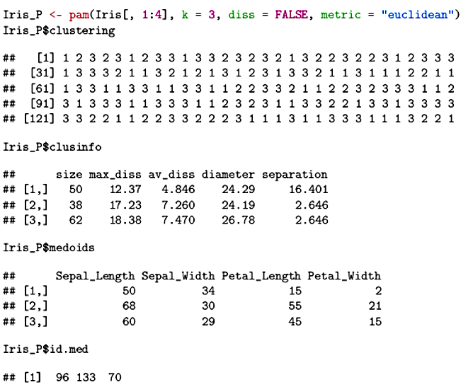
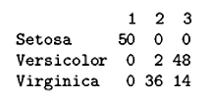

Slide 7
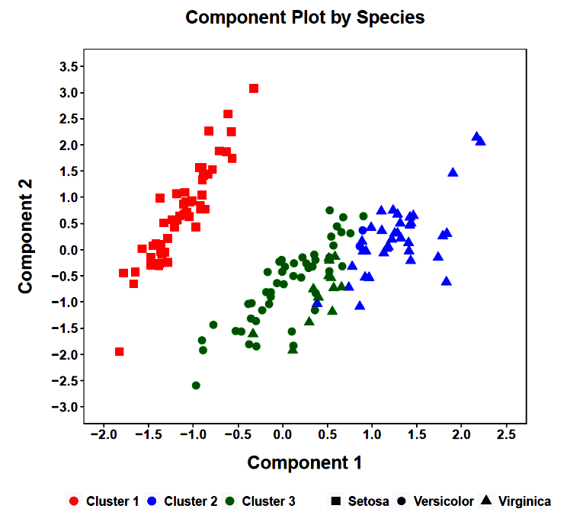

Slide 8
Minimax clustering (Bien & Tibshirani, 2011) is an alternative hierarchical method that resembles PAM in that at each step the method identifies the most highly representative object (the prototype) for the cluster that has been formed.
Bien, J., & Tibshirani, R. (2011). Prototype selection for interpretable classification. Annals of Applied Statistics, 5, 2403-2424.
Notes:
One desirable feature of this method, apart from identifying prototypes for each cluster, is that when a dendrogram is cut at a particular height, H, every observation in the dataset is within H of its cluster's prototype.

Slide 9

The linkage in this method is the radius of the smallest enclosing ball, centered at a point chosen from the two clusters being considered for joining.
This is done by identifying the object whose farthest distance from another object (max) is the closest (min). This central object is the prototype for the newly formed cluster.
Notes:
One desirable feature of this method, apart from identifying prototypes for each cluster, is that when a dendrogram is cut at a particular height, H, every observation in the dataset is within H of its cluster's prototype.

Slide 10
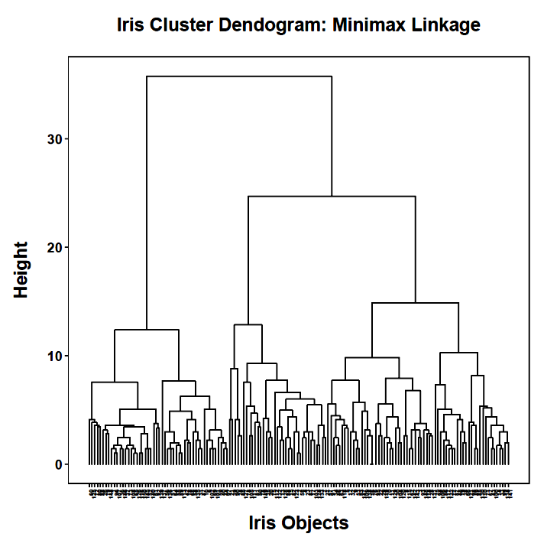
77
96
81

Slide 11
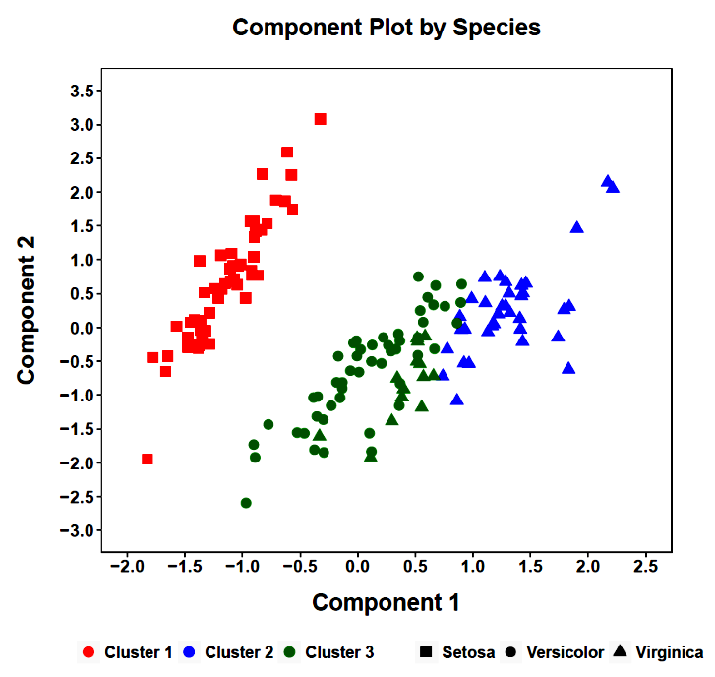
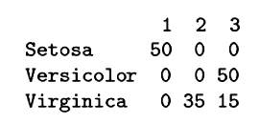

Slide 12
One limitation to hierarchical and partitioning methods is that they work best for circular, spherical, or convex clusters. When clusters have more unusual shapes, then these traditional methods struggle.
Density-based clustering can provide a solution for finding unusual cluster shapes. The most popular algorithm is called DBSCAN, which stands for density-based spatial clustering and application with noise. The goal of DBSCAN is to identify dense regions.
Notes:
In Euclidean space, a convex region is a region where, for every pair of points within the region, every point on the straight line segment that joins the pair of points is also within the region.
The noise part is important because the method recognizes that some objects may not fit neatly into any clusters and resemble noise.
Two parameters are required for DBSCAN: epsilon (“eps”) and minimum points (“MinPts”). The parameter, eps, is the radius of neighborhood around a point, x. The area enclosed by this radius is called the επσιλον-neighborhood of x. The parameter MinPts is the minimum number of neighbors that must be within epsilon-neighborhood. Using these parameters, we can define different kinds of points. A core point has a neighbor count greater than or equal to MinPts. A border point has neighbors less than MinPts, but it belongs to the epsilon-neighborhood of another point. A noise point (also called an outlier) is neither a core nor a border point.
These point definitions are then used to define three additional features: direct density reachable, density reachable, and density connected. A point “A” is directly density reachable from another point “B” if “A” is in the $\epsilon$-neighborhood of “B” and “B” is a core point. A point “A” is density reachable from “B” if there are a set of core points leading from “B” to “A.“ Two points “A” and “B” are density connected if there is a core point “C”, such that both “A” and “B” are density reachable from “C.”
The DBSCAN algorithm works as follow:
For each point, x_{i}, compute the distance between x_{i} and the other points.
Find all neighbor points within distance eps of the starting point (x_{i}).
Each point, with a neighbor count greater than or equal to MinPts, is marked as a core point.
For each core point, if it is not already assigned to a cluster, create a new cluster.
Find recursively all its density-connected points and assign them to the same cluster as the core point.
Iterate through the remaining unvisited points in the dataset.
Those points that do not belong to any cluster are treated as noise.

Slide 13
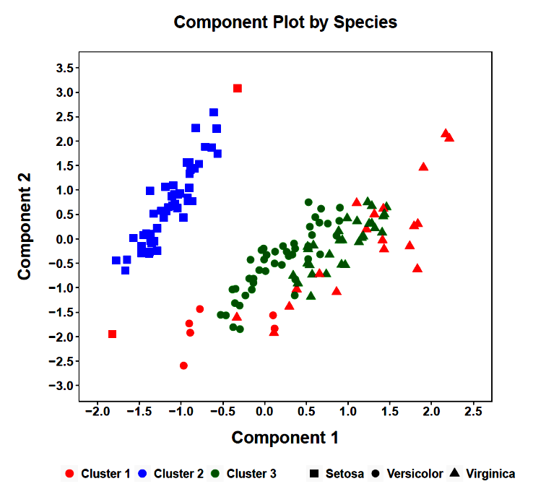
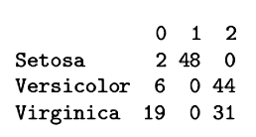
0 = noise

Slide 14
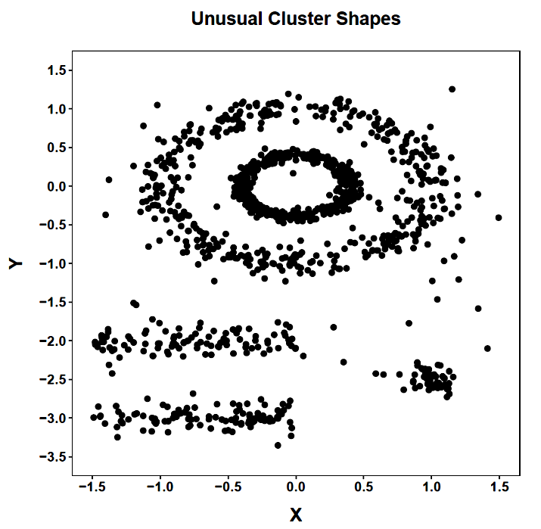
DBSCAN is particularly suited for finding unusual shapes.

Slide 15
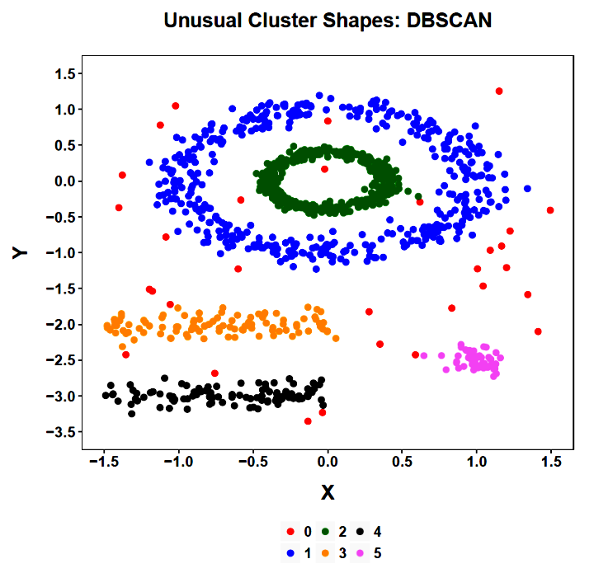
The unusual shapes are recovered. Noise is recognized as such.

Slide 16
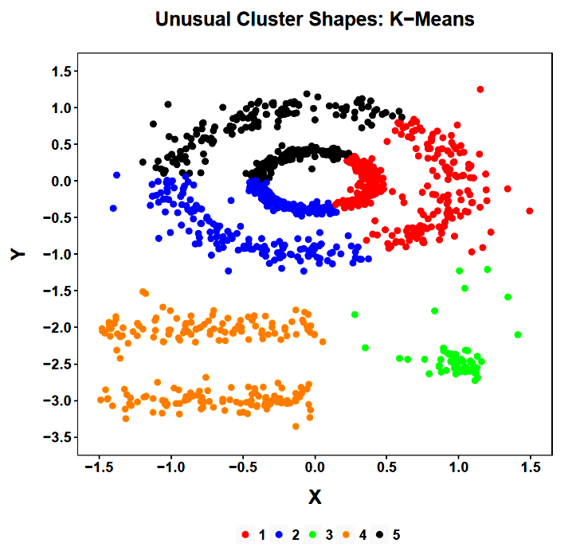
The K-Means method is able to recover just one of the original shapes, a relatively circular one.

Slide 17
In fuzzy clustering, data objects are treated as members of all clusters with varying degrees of fuzzy membership, indexed by a probability between 0 and 1. Objects closer to the centers of clusters have higher degrees of membership than objects nearer the borders of clusters.
This provides a way to gauge the certainty or confidence with which objects can be classified into categories.

Slide 18
In the Fuzzy C-Means (FCM) clustering algorithm (Bezdek,1974, 1981) the parameter, m, specifies the amount of “fuzziness” of the clustering result.
The default value is 2. As m increases, fuzzier clusters are produced. When m is 1, FCM produces the same results as the K-Means procedure.
Bezdek, J.C. (1974). Cluster validity with fuzzy sets. Journal of Cybernetics, 3, 58-73.
Bezdek J.C. (1981). Pattern recognition with fuzzy objective function algorithms. New York: Plenum.

Slide 19
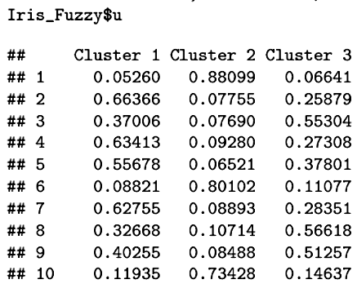
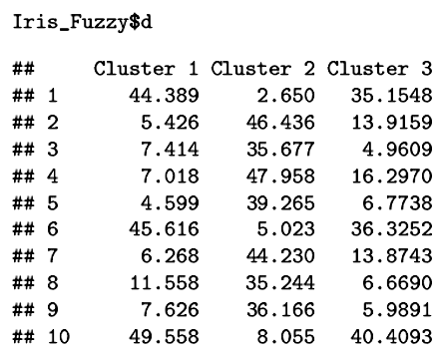

Slide 20
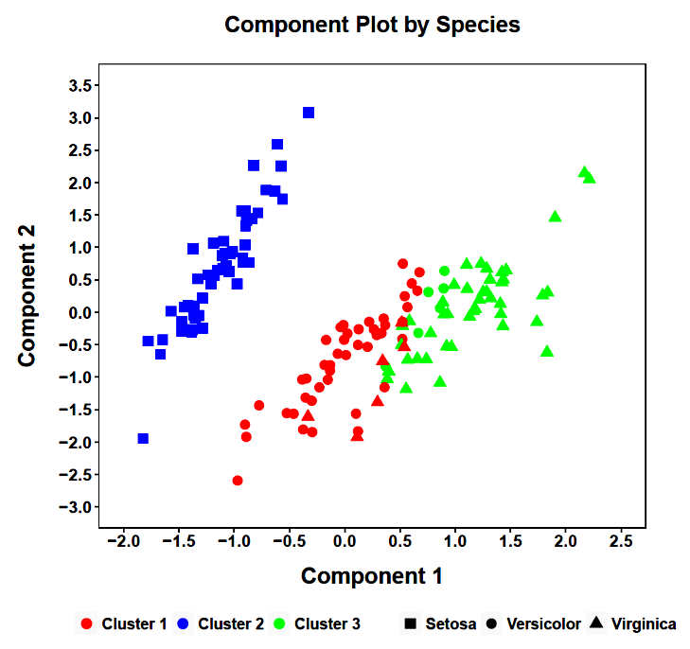
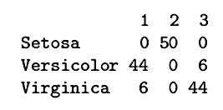

Slide 21
A dissimilarity matrix can be represented in graph theory as an undirected graph with objects as vertices (or nodes) and distances as edge weights. A minimum spanning tree (MST) is then the subset of the edges that connect all the vertices together without any cycles and with the minimum possible sum of edge weights.

Slide 22
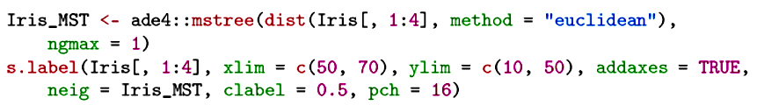
In simple terms, if the data have a cluster structure, a minimum spanning tree will have numerous interconnected paths within a cluster but few paths between clusters. The restriction that there be no cycles can be relaxed and successive layers of minimum edges added to the graph. This can highlight clustering in the data to the extent that within-cluster edges outnumber between-cluster edges.

Slide 23
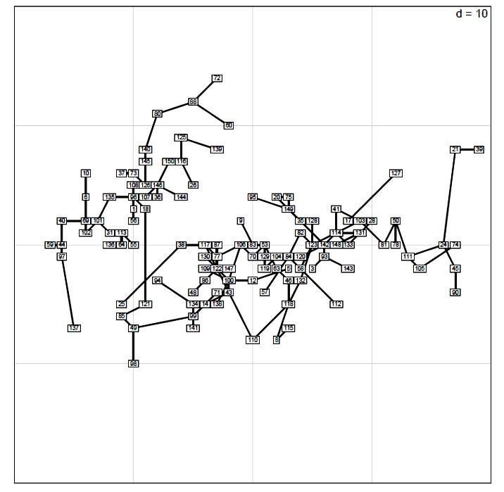

Slide 24
The "quality" of a clustering solution can be assessed in a number of ways. Here are some of the more popular ones:
Silhouette coefficient
Cophenetic correlation
Pseudo F
Hopkins statistic
Duda-Hart statistic
Gap statistic
Rand coefficient

Slide 25
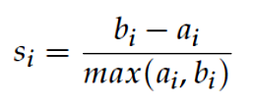
The silhouette score is calculated using two values for each object, a_{i} and b_{i}. The value, a_{i}, is the average distance between Object_{i} and all other objects in the same cluster. The value, b_{i}, is the smallest average distance of Object_{i} to all objects in another cluster. These two values are sometimes called cohesion and separation, respectively.
The silhouette score (sometimes called its width), s_{i}, is defined as:

Slide 26
Silhouette scores can take on values between -1 and 1, with higher values indicating that an object is well matched to its cluster and a poor match to any neighboring clusters.
The average silhouette score is provided for each cluster and for the overall solution. The overall average, sometimes called the silhouette coefficient, is an index of cluster quality.
Coefficients that approach 1 represent very clear evidence that the chosen cluster number produces a good cluster solution.

Slide 27
Some common benchmarks for the average cluster silhouette coefficient:
.71 to 1.00 A strong structure has been found
.51 to .70 A reasonable structure has been
found
.26 to .50 The structure is weak and could be
artificial
< .25 No substantial structure has been
found

Slide 28
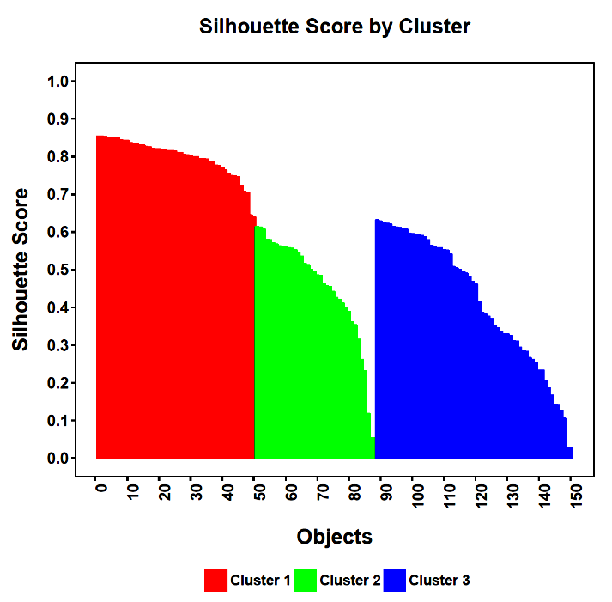
The average silhouette for the three-cluster solution (.55) with the Iris data suggest that a reasonable structure has been found but some cases (other than Setosa members) are clearly easily moved.
.80
.45
.42
Notes:
From the PAM solution.

Slide 29
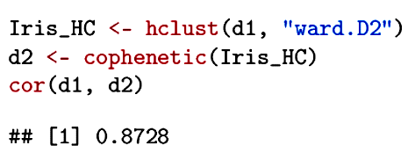
The cophenetic distance between two observations that have been clustered hierarchically is defined to be the intergroup dissimilarity at which the two observations are first combined into a single cluster.
The correlation between the original distances and the cophenetic distances is an index of how well a dendrogram preserves the pairwise distances between the original objects.

Slide 30
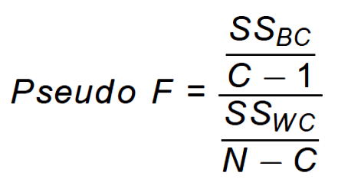
The Calinski-Harabasz (Pseudo F) statistic closely resembles the F test in ANOVA:
These values can be displayed for different numbers of clusters, with the maximum indicating the best number of clusters in the sense of maximizing their separation and cohesion.

Slide 31
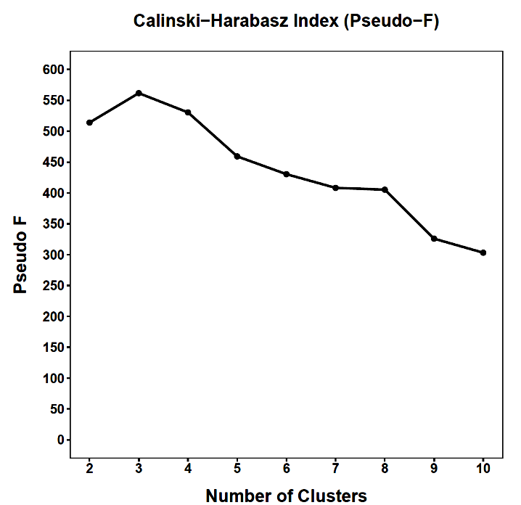
Three clusters in the K-Means method are optimal.

Slide 32
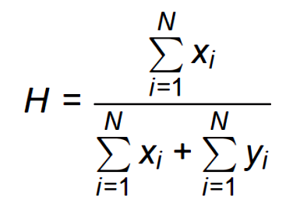
The Hopkins statistic examines whether objects in a data set differ significantly from the assumption that they are uniformly distributed in the multidimensional space. It compares the distances, x_{i}, between the real objects and their nearest neighbors to the distances, y_{i}, between artificial objects and their nearest neighbors, with the artificial objects uniformly generated over the data space.

Slide 33
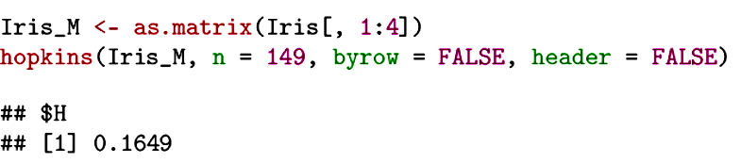
Values close to .5 indicate data are uniformly distributed. As H approaches 0, the data exhibit increasing clustering.

Slide 34
The Duda-Hart test indicates if a data set should be split into two clusters. It thus represents a very basic test that indicates if clustering is justified.
Variants exist for different clustering methods.
The one used here is suitable for interval level data for which sums of squares would be an appropriate calculation. The dh value calculated here is the ratio of the within-cluster sum of squares for two clusters to the overall sum of squares.

Slide 35
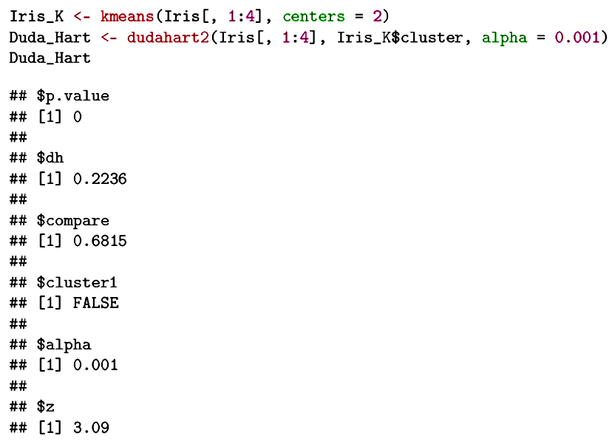
The data depart significantly from a single cluster solution.

Slide 36
The gap statistic (Tibshirani et al., 2000) compares the within-cluster dispersion to that expected under an appropriate reference null distribution, which assumes random dispersion (e.g., uniform or Gaussian on the range of the original variables or a simplified space [e.g., PC]).
The latter is defined by bootstrapping from the null reference distribution. As the obtained WSS curve departs (“gap”) from that expected under the reference curve, there is evidence for non-random lumpiness in the data.

Slide 37
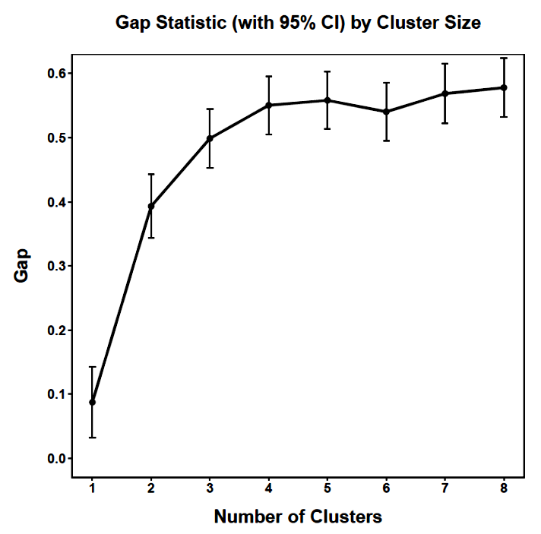
In the Iris data there is no significant improvement beyond three clusters and the evidence for three is reasonably strong.

Slide 38
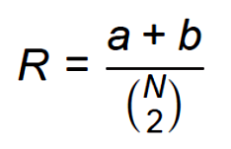
The Rand coefficient can be used to compare two clustering methods. The simple Rand coefficient is given by:
in which a is the number of times a pair of objects is classified together across the two methods and b is the number of times a pair of objects is classified in different clusters across two methods. The denominator is the number of unique pairs of objects. A corrected version of the Rand Coefficient that takes chance agreement into account.

Slide 39
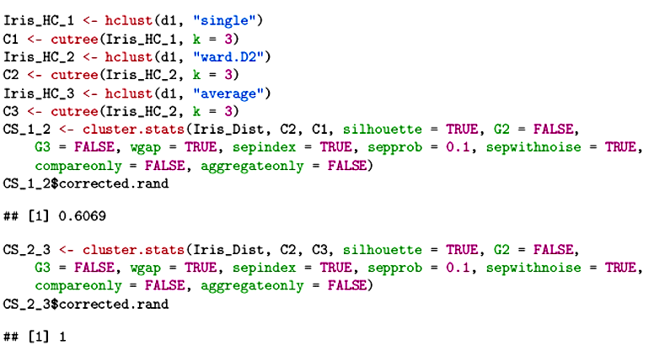
Ward’s method agrees poorly with the single linkage method but very well with the average linkage method.

Slide 40
For all of the data sets examined in past examples, all measures shared the same level of measurement (e.g., interval). When measures with different levels of measurement, the Gower distance provides a way to combine them.
For each variable type, a particular distance metric that works well for that type is used and resulting distances scaled to fall between 0 and 1.
The distances for each pair of objects are then averaged to create the final distance matrix.
The Gower distance is always a number between 0 (identical) and 1 (maximally dissimilar).

Slide 41
Simply knowing the number and size of clusters in a data set is an important goal. But, sometimes we want to know more than that. The next step beyond identification of clusters is prediction of cluster membership using additional variables.

Slide 42
Next time . . .
Discriminant analysis

